Slide 1
SmartSplit
CSCI 6907
Full Stack Application Development
Professor: Timothy Kim
Presenters -
Ashwini Prabhu Rahul Dhamnani
Mruganka Londhe Shuo Zhang
Yifei Shen

Slide 2
Agenda
Introduction
Technologies Used
Tradeoffs
Architecture of Application
Demo
Class Lessons Incorporated
Development Questions
Future Enhancements

Slide 3
Introduction
What is SmartSplit
SmartSplit is a website that allows the user to split bills with roommates, friends and family.
Why we decide to built it
We believe living graduate/undergraduate school life we all have a lot of shared bills
Features of SmartSplit
Register/ Login/ update user (User Management)
Display Dashboard, Transactions with a Friend, Details of a Transaction
Add/Update/Delete expense
Settle up

Slide 4
Technologies Used
Java
Object oriented
All members are comfortable using Java
MySQL
Relational Database
Easy to install and use
SQL
Hibernate
Remove overhead of database connections, handling exceptions, database keys
Makes code independent of Database
Spring
Spring utilizes some of the well-known technologies, like ORM, logging framework, JSON Wrapper, which has been implemented in the project
JSP
Since our codebase is written in Java we wanted scripting language that works with Java
Easy to write frontend pages
Supports JSON objects
Maven
Maven can easily manage all the dependencies in the project.
Makes Testing of code simple

Slide 5
Tradeoffs
Java and not Python
Relational database and not NoSQL database
Hibernate and not JDBC
Why Spring

Slide 6
Architecture of Application
Server
Core Business Logic
DAO (JAVA)
Internal
Web API
ORM (Hibernate)
External
Internal
Client (Browser)
Database (MySQL)
Client Web App
(HTML/CSS/JS)

Slide 7
Application Demonstration
SmartSplit

Slide 8
Class Lessons Incorporated
Microservices
RESTful APIs
Simple Algorithms
Test

Slide 9
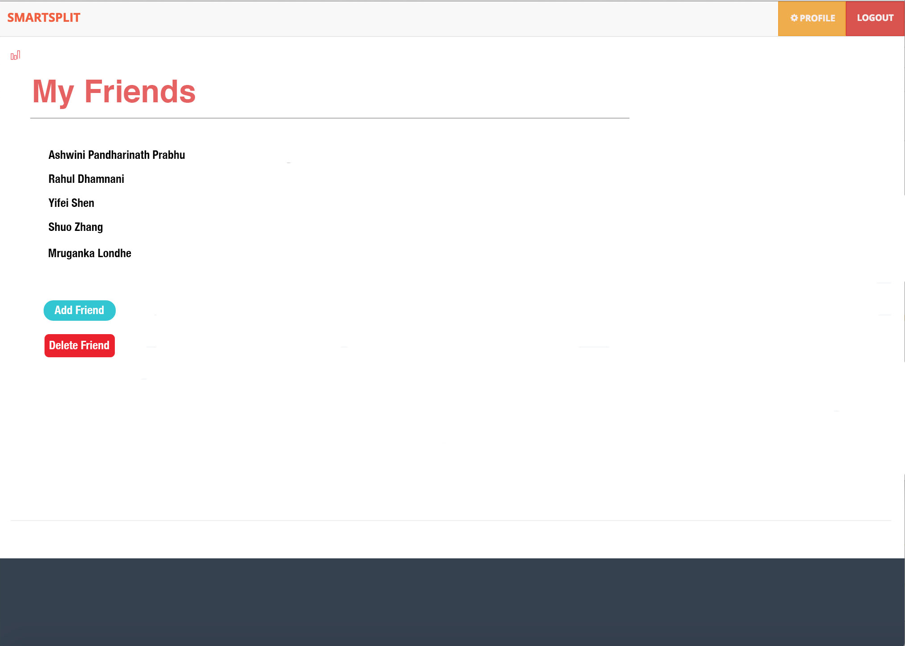
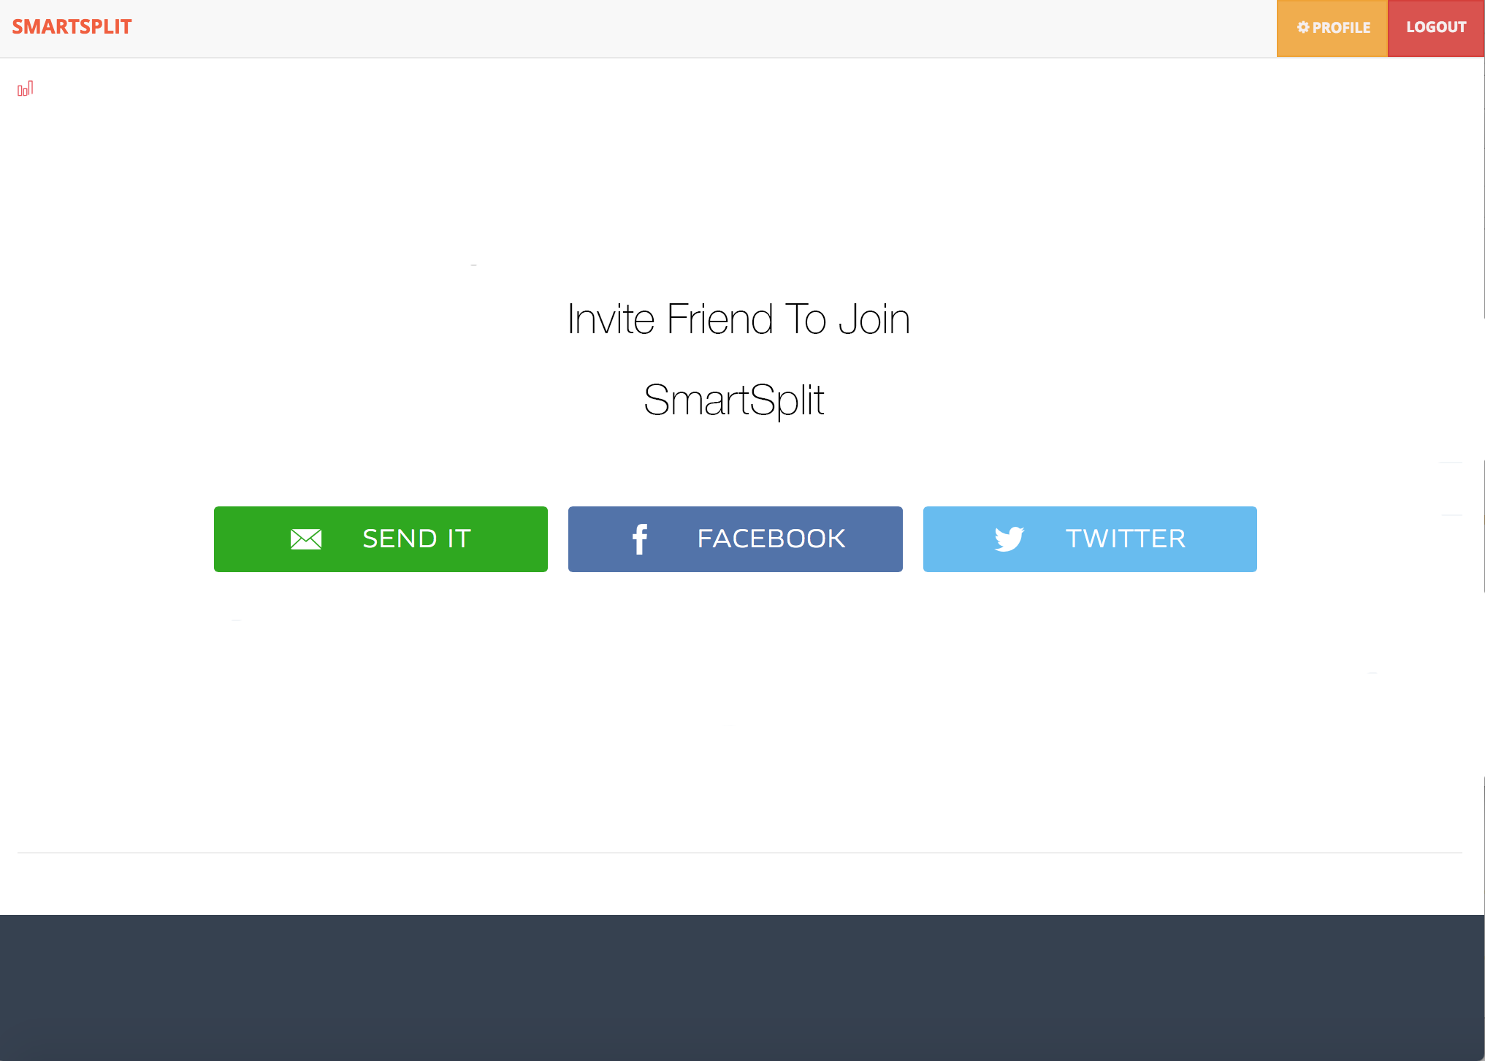
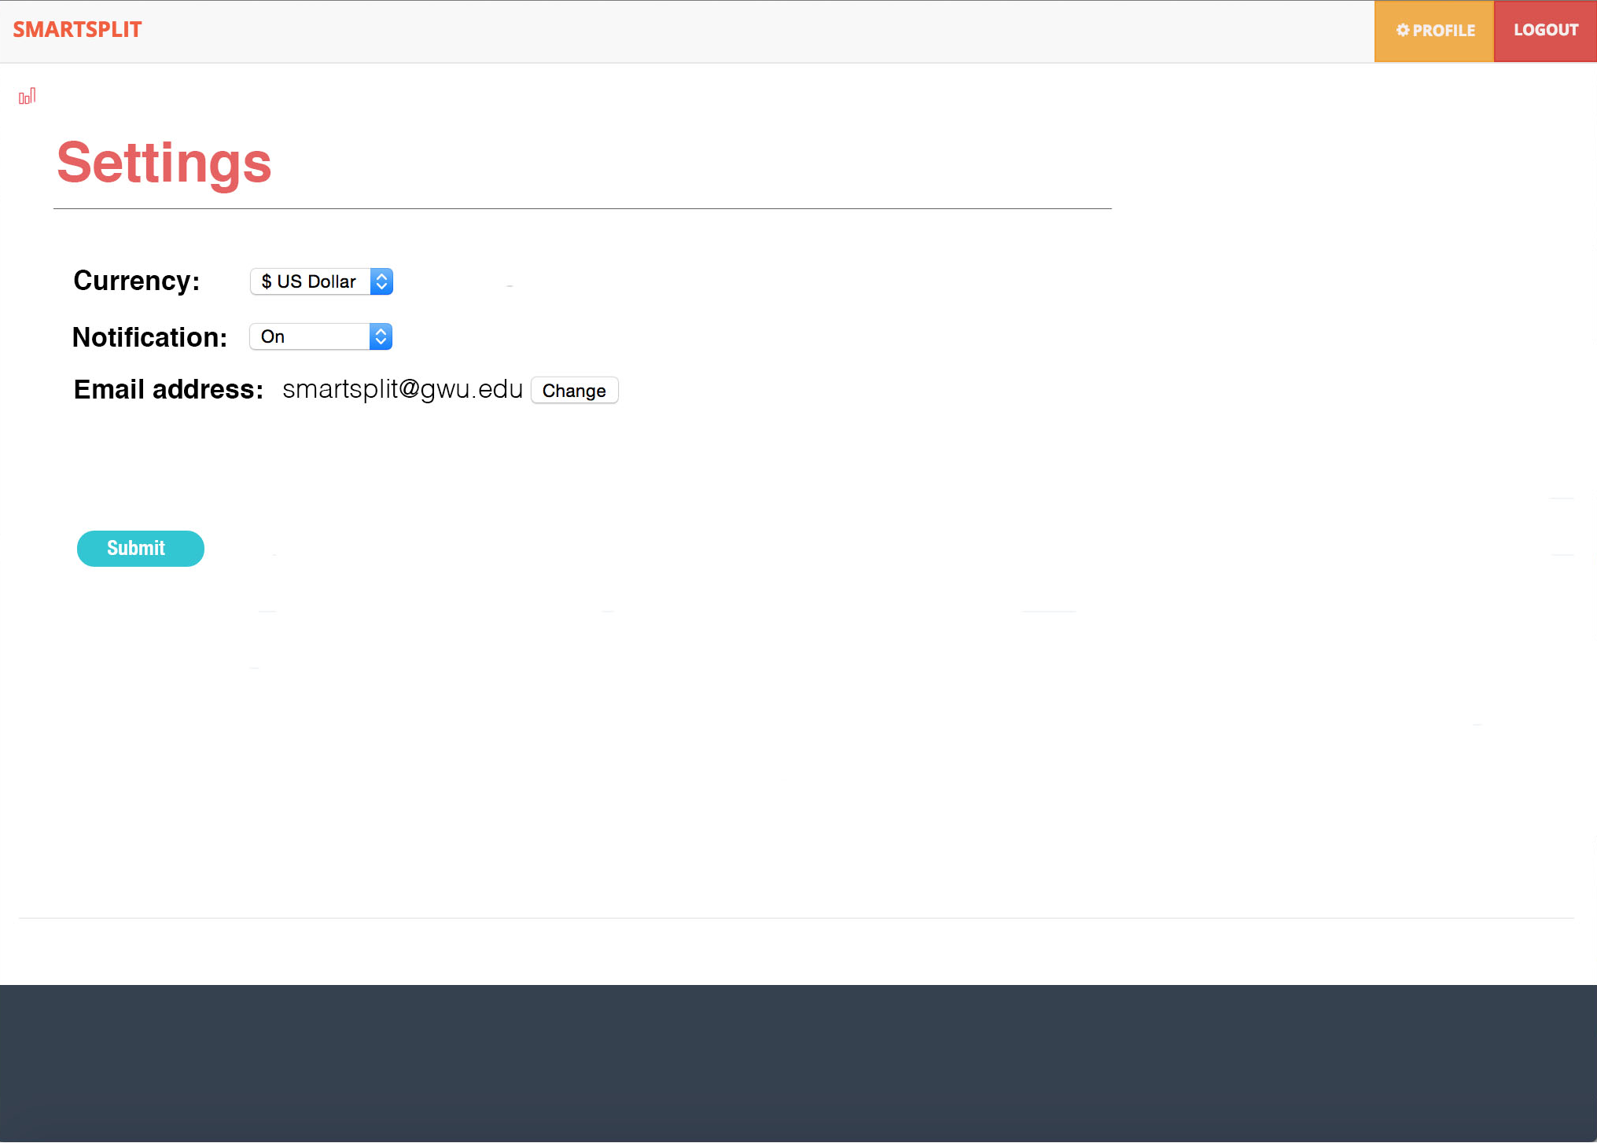
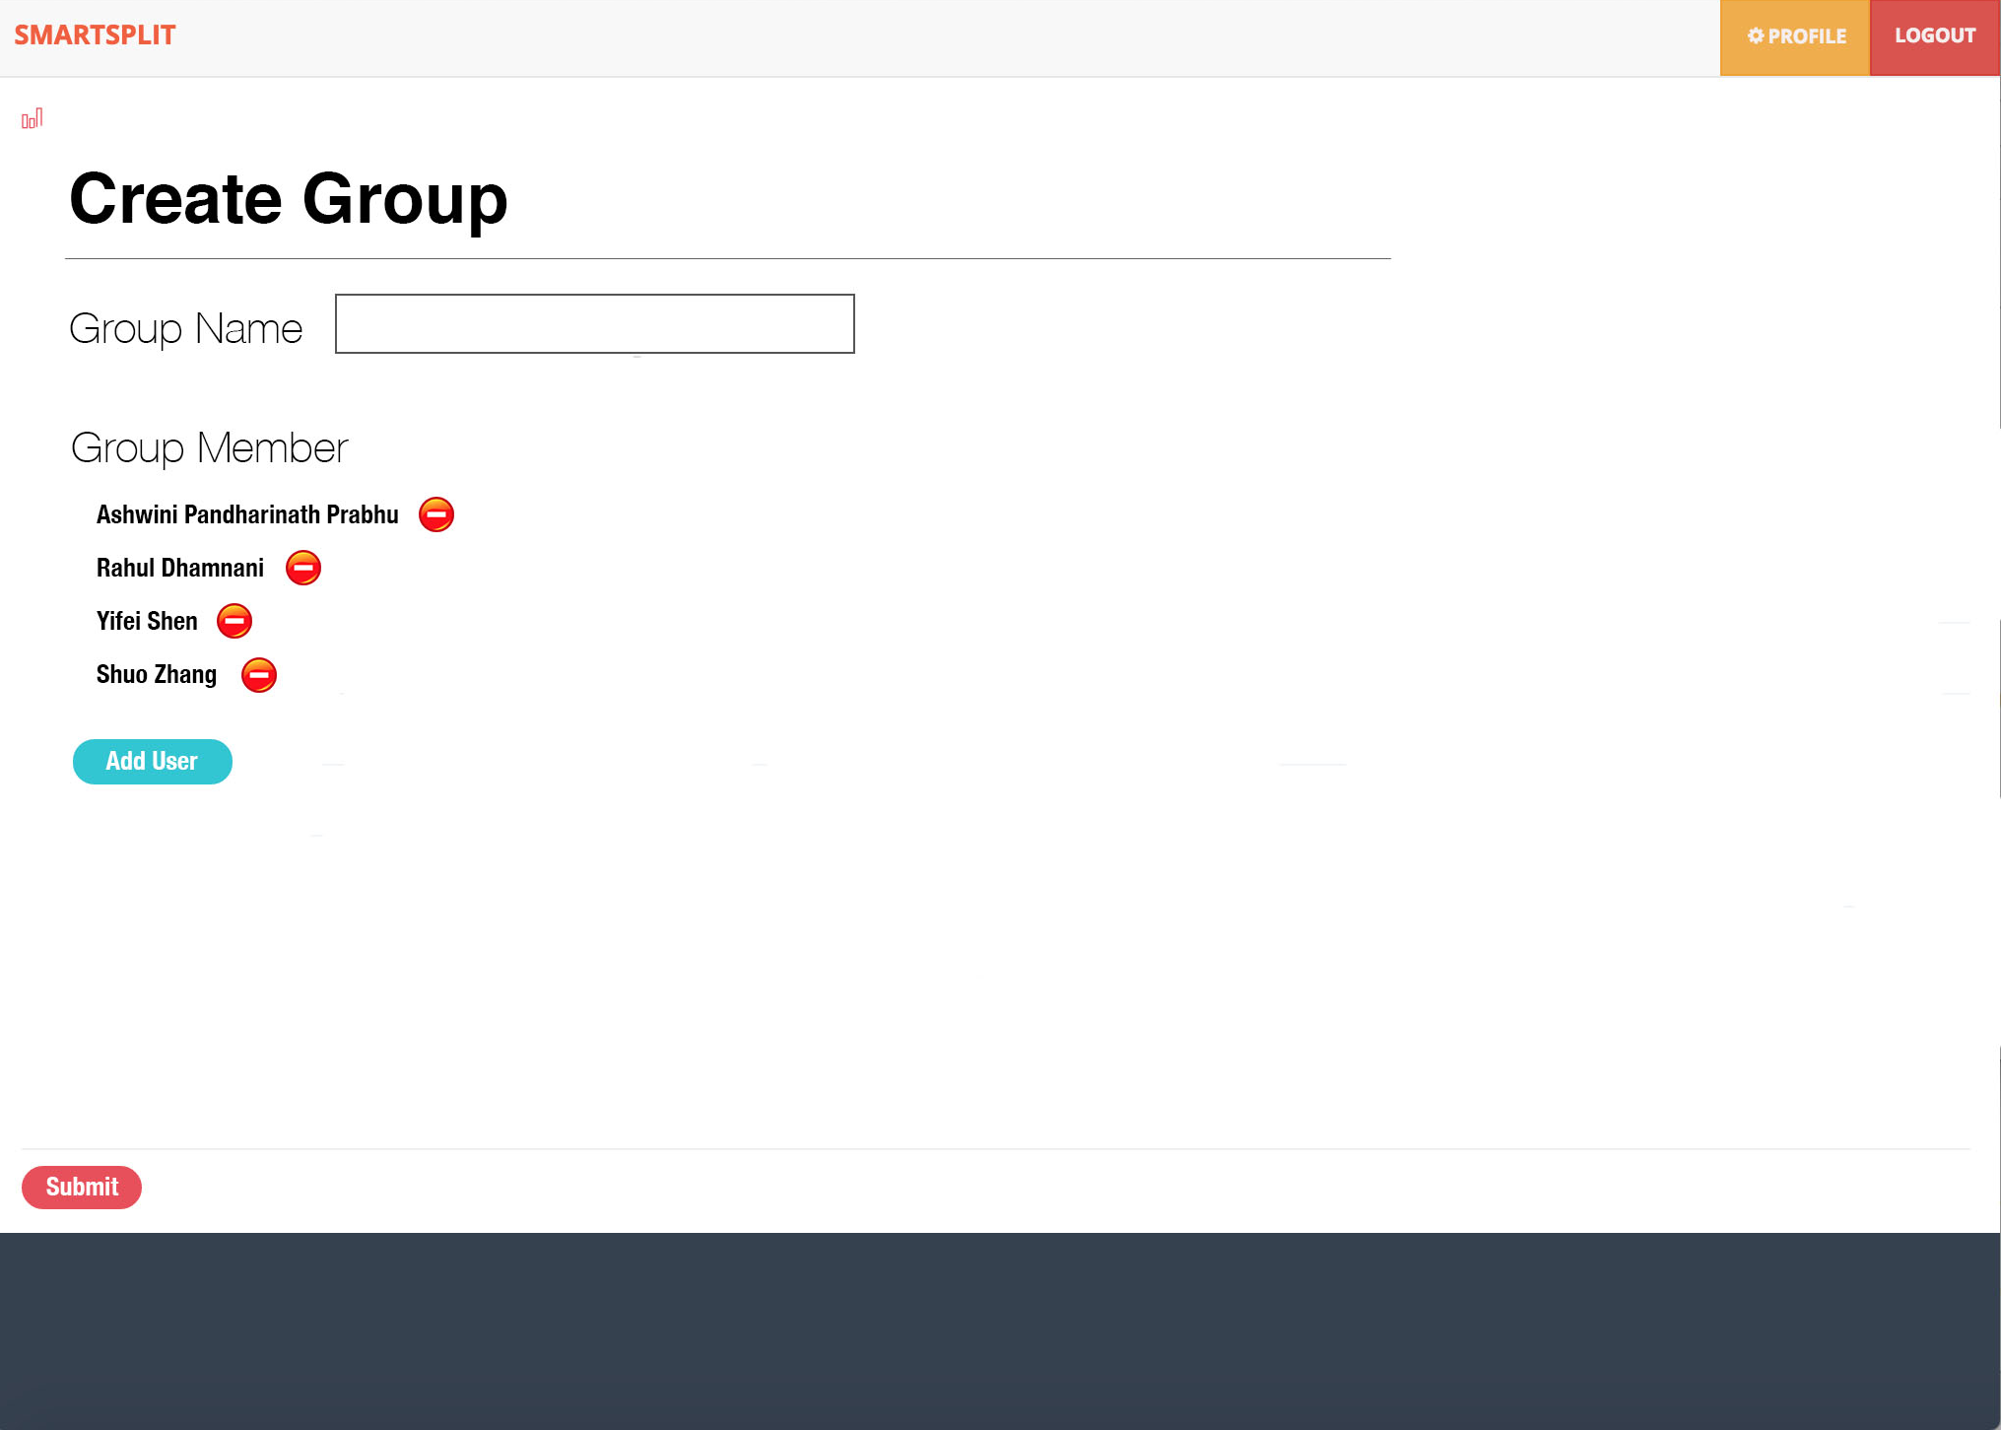
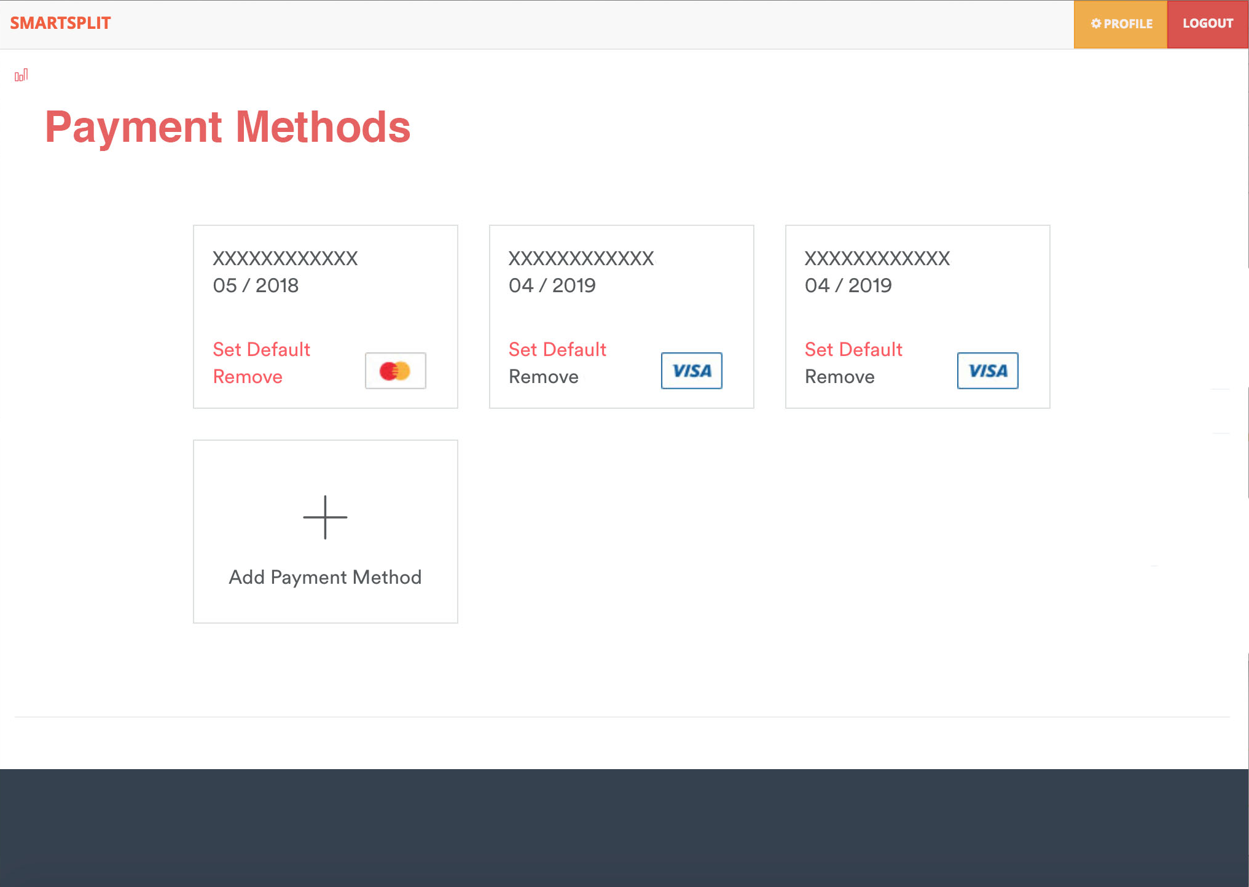
Future Enhancements

Slide 10
Development Questions
Easiest Parts
Hardest Parts
Different Decision if any
Work Distribution
Group Difficulties

Slide 11
Thank you!! Any Questions?

